Slide 1

Unit 16 – Procedural Programming
with Ben Read

Slide 2
AIMS & OBJECTIVES
Comprehend the use of advanced function types
Analyse code examples to determine their optimal usage
Partake in a self-paced tutorial to revise concepts covered in this session

Slide 3
PARAMETERS
Function arguments are the actual values of the variables passed to a function. A function must have declared variables in order to accept passed arguments.
A function variable that accepts an argument is known as a function parameter. Function arguments are commonly referred to as actual parameters and function parameters are referred to as formal parameters. However, for the purposes of this unit they are known as arguments and parameters.

Slide 4
PARAMETERS
int main()
{
//Actual parameters
add(10, 20); //Function call
return 0;
}
//Formal Parameters
Void add(int num1, int num2)
{
//Function body
}
You can pass a value to a function in two ways –
Call by value
Call by reference

Slide 5
RETURN STATEMENTS
A function is a collection of statements grouped together to do a specific task. It may return a value. However, in no case can a function return more than one value. What do we mean by returning a value and where is it returned from?
To understand this let us consider the following example:

Slide 6
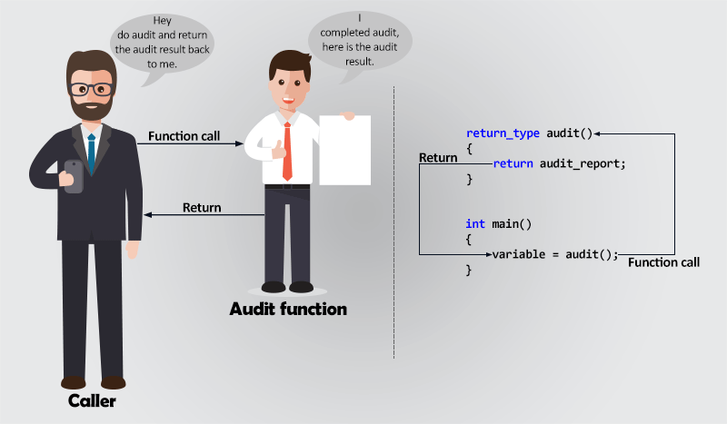
RETURN STATEMENTS
Suppose you are the boss of a company. You assign an audit task to one of your employees. Consider the audit task as a function. The employee will complete the task - execute the function - and return the audit report back to the boss, i.e. You. Similarly, a function returns a value and program control back to the caller function.

Slide 7
RETURN STATEMENTS
The return statement terminates a function and transfers program control to the calling function. It may optionally return a value to the caller. You can use a return statement anywhere inside a function but once control has been returned to the caller the function will cease operation, its memory will be cleared, and any non-static local variables will be wiped.
Note: The functions return value type must match the datatype from the function’s declaration statement, e.g.
int max(int num1, int num2)
{
//Operations
return an_integer_value; //Datatype must be the same
}

Slide 8
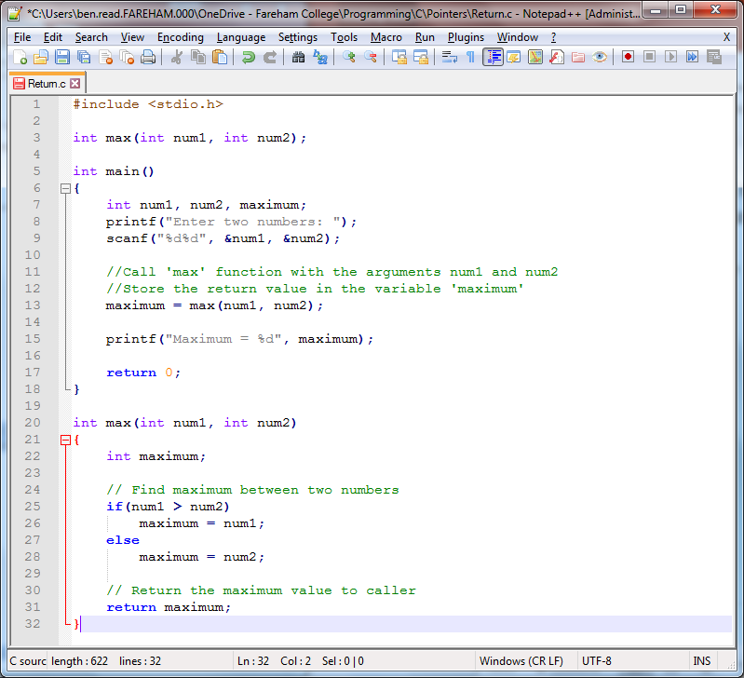

Slide 9
CALL BY VALUE
Call by value is the default mechanism to pass arguments to a function. In call by value, during the function call the argument, or actual parameter, value is copied and passed to the formal parameter. Changes made to the formal parameters do not affect the actual parameters.
The only way to receive output from a function when using call by value is with the functions single return value.
To understand this let us consider an example of swapping two numbers using a function.

Slide 10
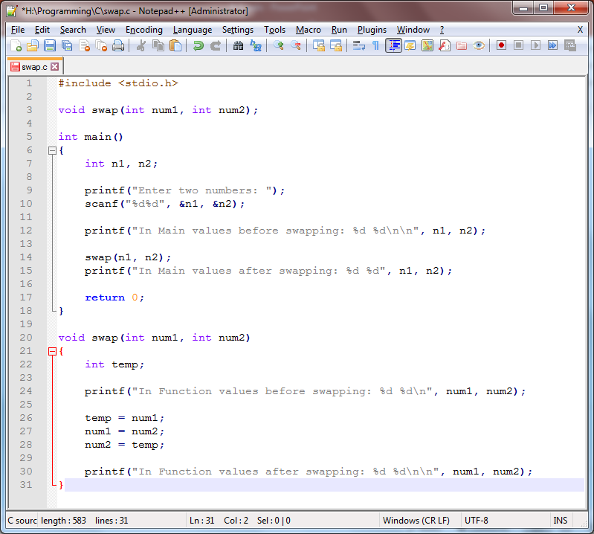

Slide 11
CALL BY VALUE
In the program above, the swap() function does not alter the arguments’ values. During the passing of n1 and n2 to the swap() function, C will copy the value of the argument to a temporary variable and then pass this copy on to the function.
Because swap() doesn’t return a value it cannot affect anything outside of the function. Therefore it is not possible to swap the original values of n1 and n2 from within the function. At best, you would need two functions using call by value, one to return each value of the swap so they can be written back to the original variables.
This is not an ideal situation but we can resolve it using call by reference.

Slide 12
CALL BY REFERENCE
Call by reference passes the memory location (reference) of the argument’s real value to the formal parameter. It uses pointers to pass the reference of the actual parameter to the formal parameter. Changes made to the formal parameter immediately take effect on the actual parameter.
Let’s look at the swap() function again, but this time using call by reference.

Slide 13
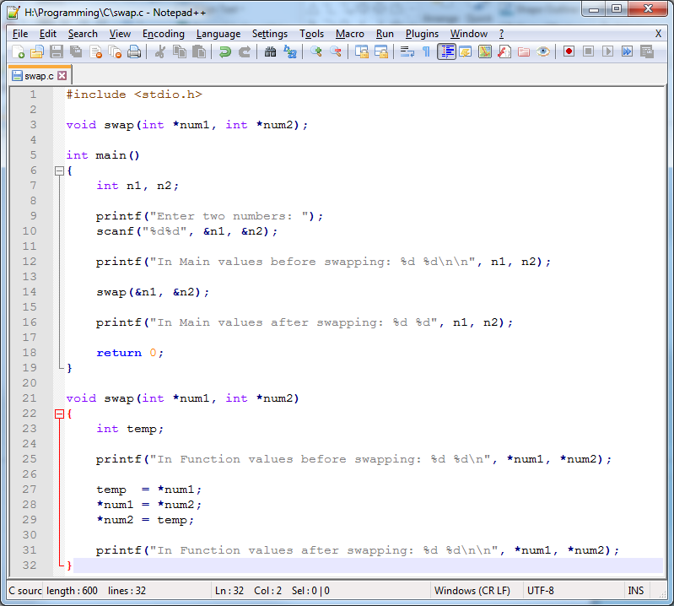

Slide 14
CALL BY REFERENCE
Because operations performed on the formal parameter are reflected on to the actual parameter, actual value swapping can be performed both inside and outside the swap() function.
By using a pointer to pass the actual address of a variable as the function is called, we were able to write back from the function directly to the external values.

Slide 15
CALL BY REFERENCE
Remember – formal parameters which are pointers require a dereference operator (asterisk) in front of them, e.g.
*num1, *num2
When calling a function which uses pointers you must send the address of the variables rather than their values by using the reference operator (ampersand), e.g.
&num1, &num2

